Slide 1

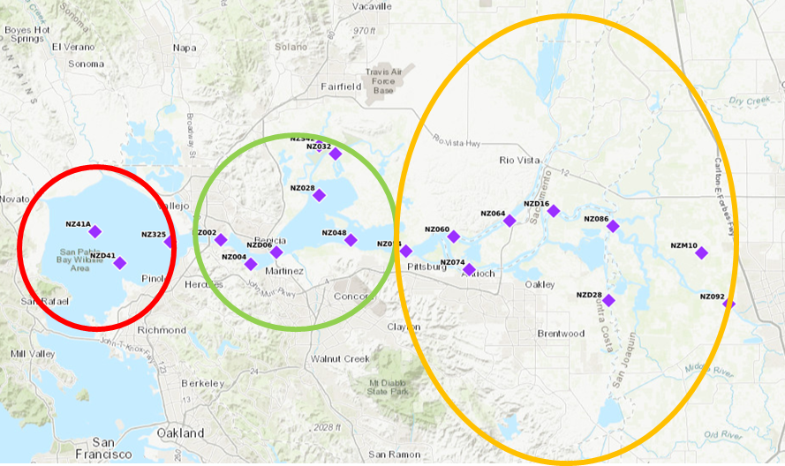
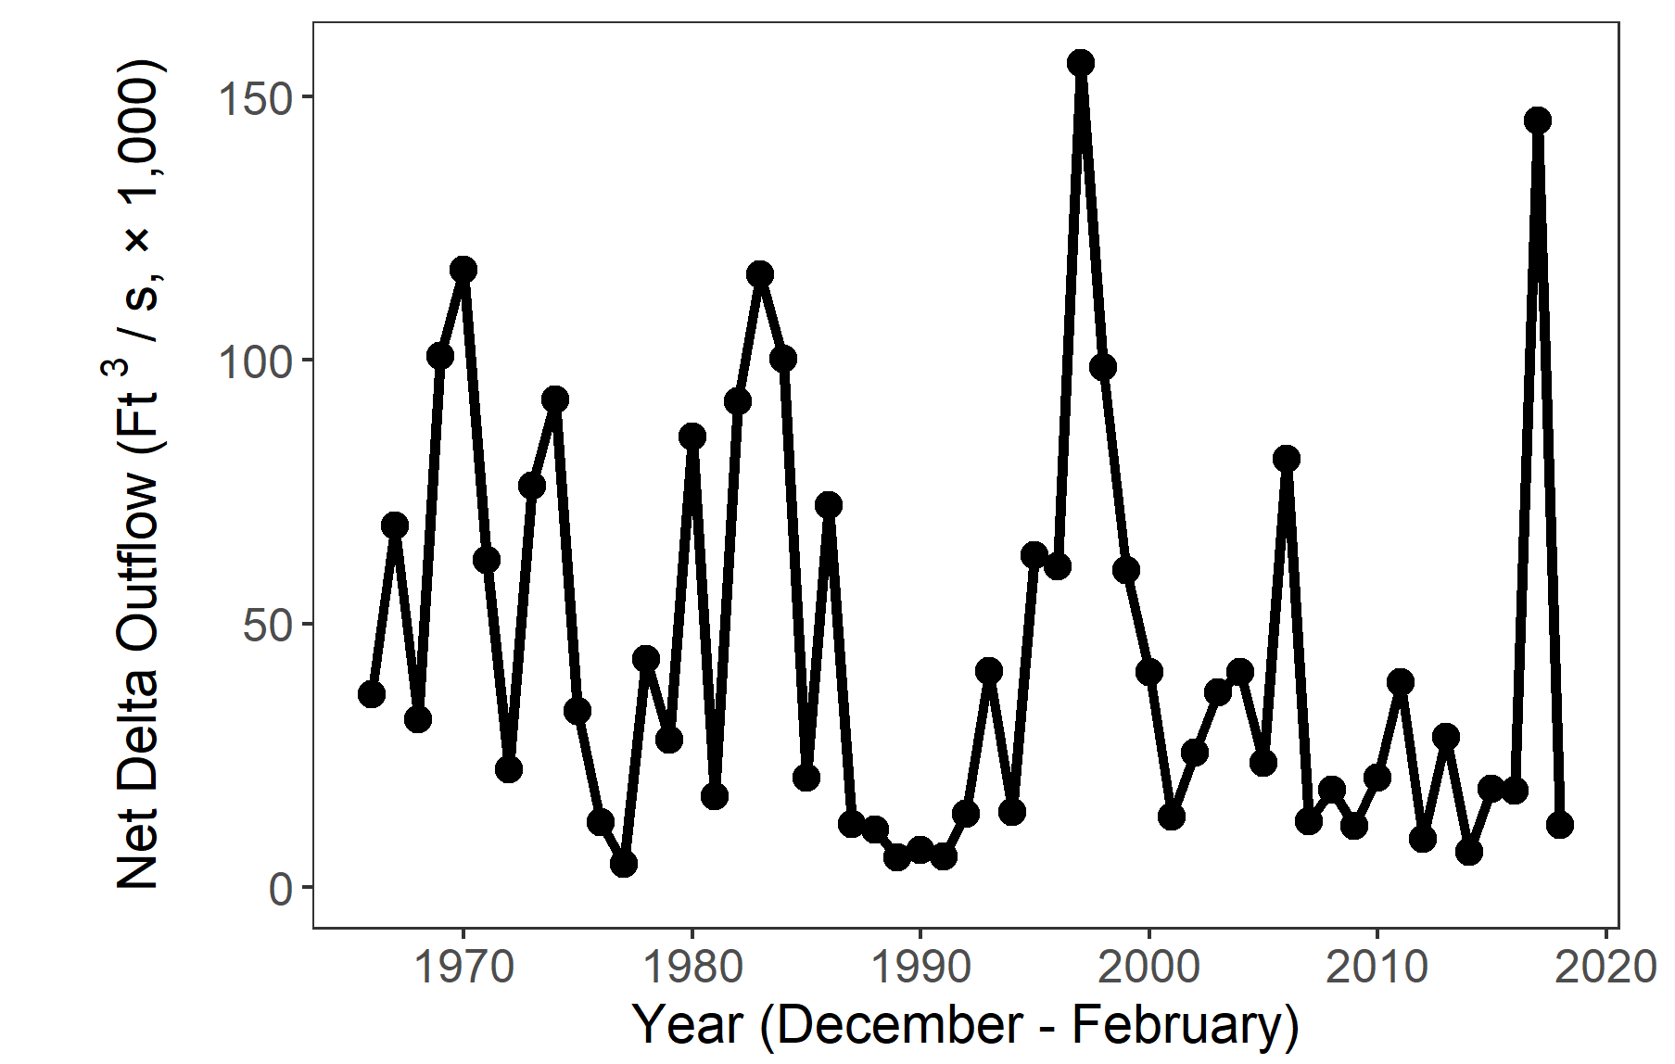
Winter 2017-2018 IEP Status and Trends Report
Interagency Ecological Program for the San Francisco Estuary
This report shows trends in water quality, plankton, and fish across multiple IEP surveys for December of 2017, January and February of 2018.
Regions of the Estuary
Delta Outflow
Contents
Secchi Depth
Temperature
Chlorophyll
Zooplankton
Smelt
Salmon
Other Fish
San Pablo Bay is salty, similar to San Francisco Bay, with influence from the Pacific Ocean.
Suisun is brackish in the summer, fresher in the winter/spring, and contains a lot of wetlands.
The Delta is fresh, with many distributary channels
Freshwater flow is one of the controlling factors in the estuary
Winter flow is driven primarily by rainfall and upstream dam releases.
DISCLAIMER: Use this data at your own risk

Slide 2
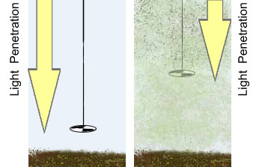
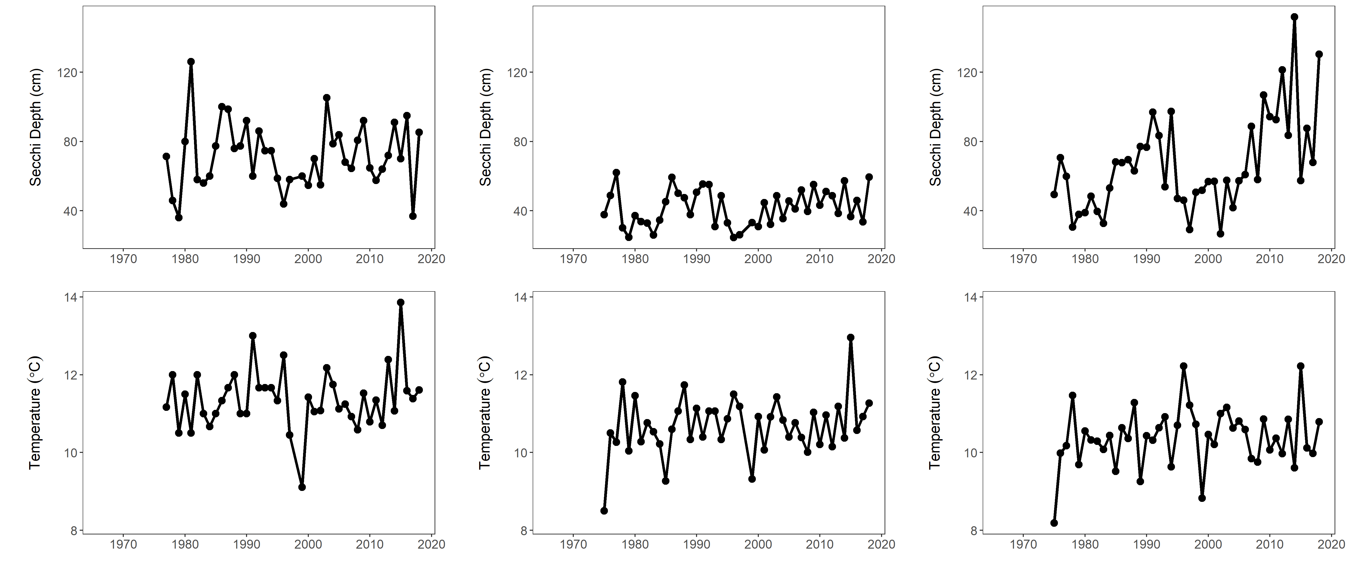
Secchi Depth
Interagency Ecological Program Status & Trends 2017-2018 Winter Season Report
Secchi disk
Organisms in this ecosystem are adapted to high turbidity conditions, and reductions in turbidity can have many negative ecological effects. Higher values for Secchi depth indicate lower turbidity.
Secchi depth is measured monthly by DWR’s Environmental monitoring program by dropping a black-and-white disk in the water until it disappears.
San Pablo Bay
Suisun Bay
The Delta
Suisun bay is usually pretty murkey, meaning low secchi depth.
San Pablo bay is pretty clear.
Suisun Bay is pretty murky (low secchi depth)
The Delta has been getting clearer over time

Slide 3

Temperature
Interagency Ecological Program Status & Trends 2017-2018 Winter Season Report
Temperature is monitored monthly by DWR’s Environmental Monitoring Program.
Most fish have temperature tolerances necessary for growth and reproduction.
Increasing winter temperatures may lower Delta Smelt fecundity.
San Pablo Bay
Suisun Bay
The Delta
Suisun bay is usually pretty murkey, meaning low secchi depth.
San Pablo Bay is slightly warmer than the Delta in the winter
Suisun Bay is usually similar to the Delta
Delta temperatures are closely linked to air temperature

Slide 4
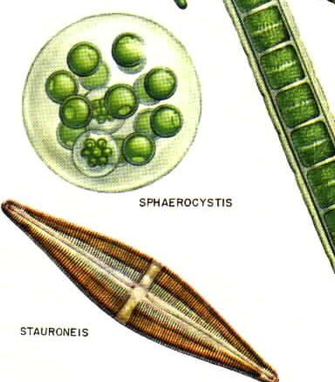
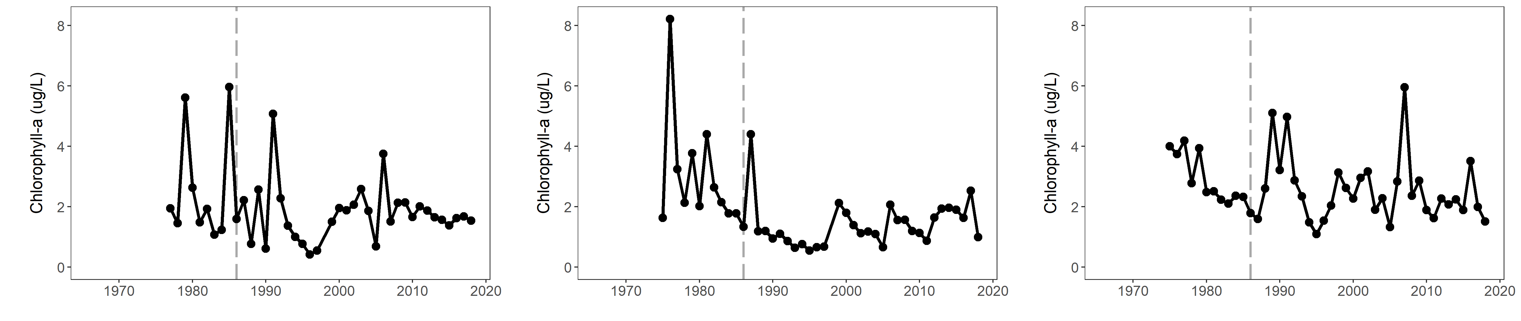
Chlorophyll
Interagency Ecological Program Status & Trends 2017-2018 Winter Season Report
Chlorophyll is an indicator of phytoplankton production, which tends to be low during the winter.
Phytoplankton are the base of the pelagic food web. It is sampled monthly by DWR’s Environmental Monitoring Program.
The invasive clam Potamocorbula amurensis caused a decline in phytoplankton and zooplankton – especially in Suisun Bay.
San Pablo Bay
Suisun Bay
The Delta
clam invasion
clam invasion
clam invasion
Winter chlorophyll has been consistently low in San Pablo Bay
The clam invasion lowered chlorophyll in Suisun more than other regions
Winter chlorophyll levels have been consistently low in the Delta

Slide 5
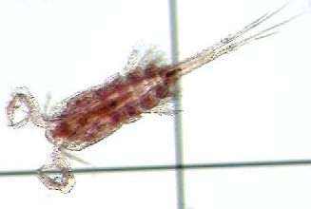
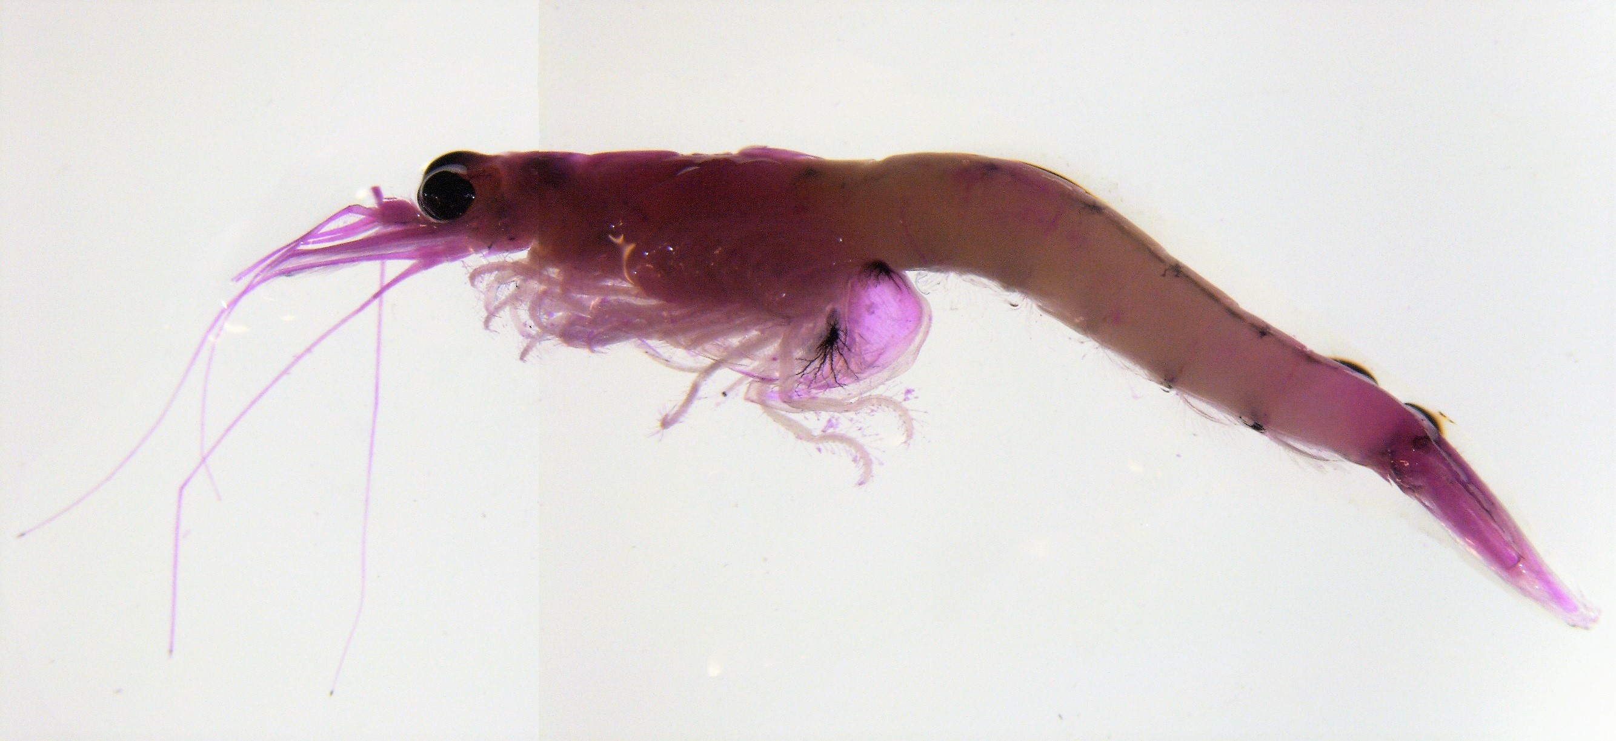
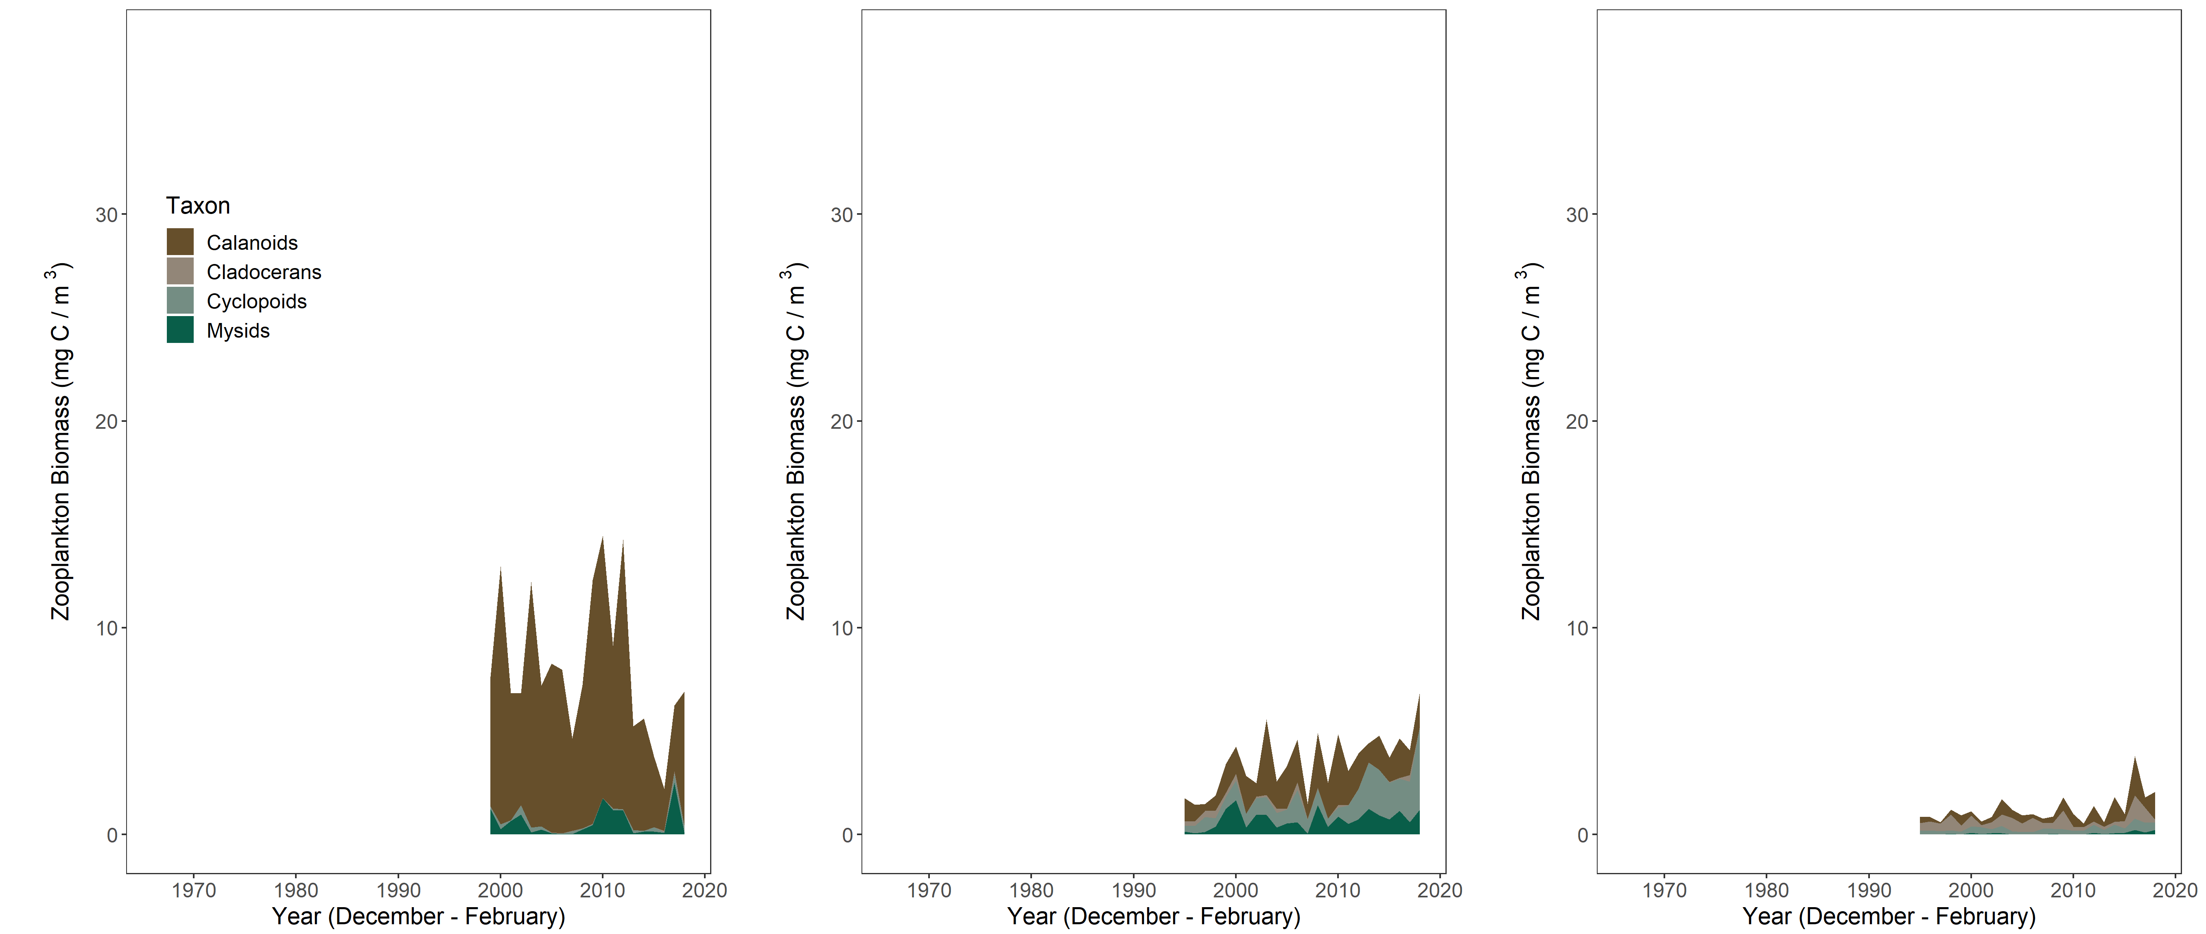
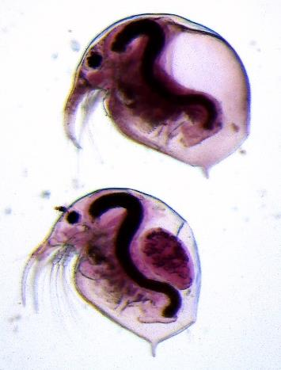
Zooplankton
Interagency Ecological Program Status & Trends 2017-2018 Winter Season Report
Zooplankton is sampled monthly by the CDFW/DWR Environmental Monitoring Program, but sampling in winter did not begin until 1995.
Zooplankton are an important food source for pelagic fish. Calanoid copepods and mysids are good fish food. Cyclopoid copepods are not as good for fish food.
Biomass tends to be low in the winter.
San Pablo Bay
Suisun Bay
The Delta
San Pablo Bay is dominated by calanoid copepods
Suisun has a lot of cyclopoid copepods
The Delta has low zooplankton abundance during the winter.
Notes:
Do we change the x axis so we can see it?
Also, Nick made these plots narrower and taller than the others.

Slide 6
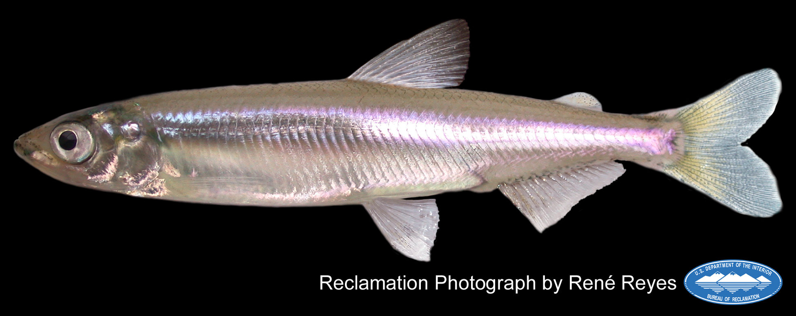
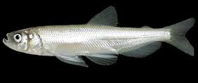
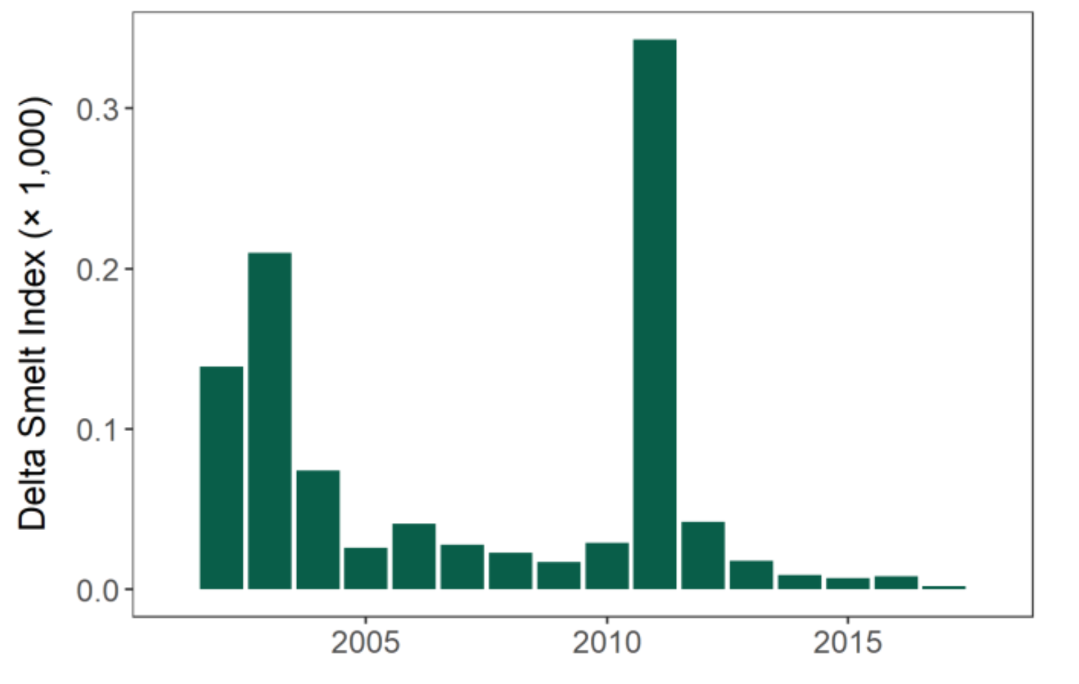
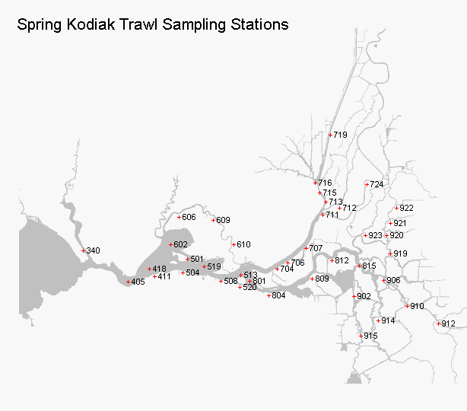
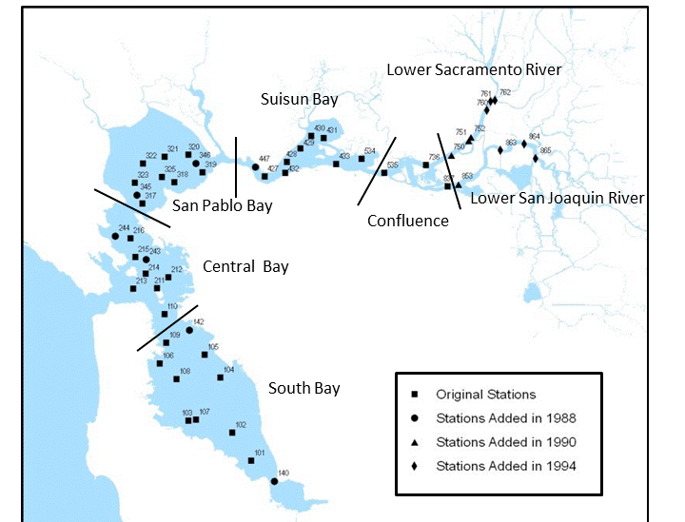
Smelt
Interagency Ecological Program Status & Trends 2017-2018 Winter Season Report
Delta Smelt - SKT
Longfin Smelt – Bay study
Delta Smelt are ESA listed as Threatened, CESA listed as Endangered and have been in decline since the early 2000s
CDFW’s Spring Kodiak Trawl is designed to monitor adult Delta Smelt from January-March.
Longfin Smelt are listed as Threatened under CESA and have been in decline since the early 2000s.
Longfin Smelt are sampled by CDFW’s San Francisco Bay Study.

Slide 7
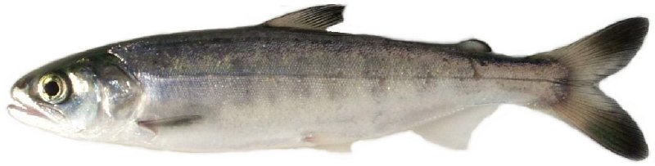
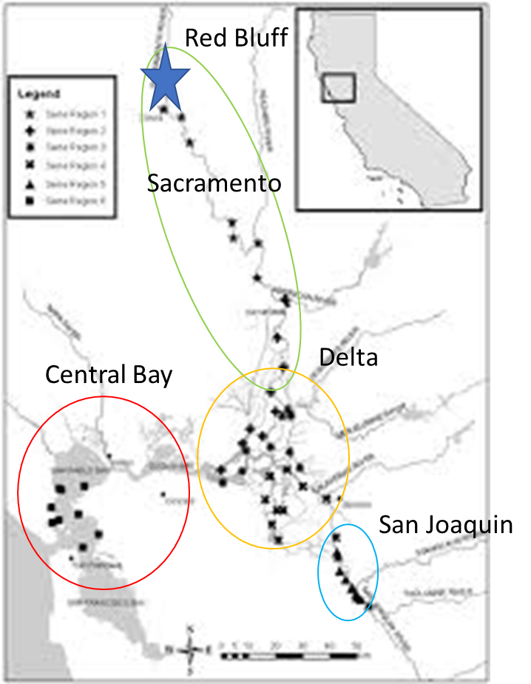
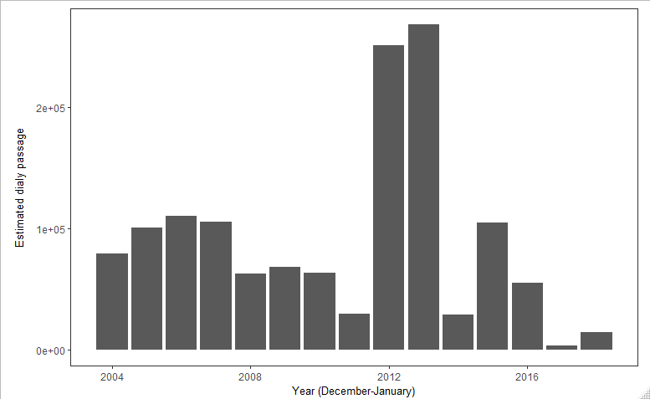
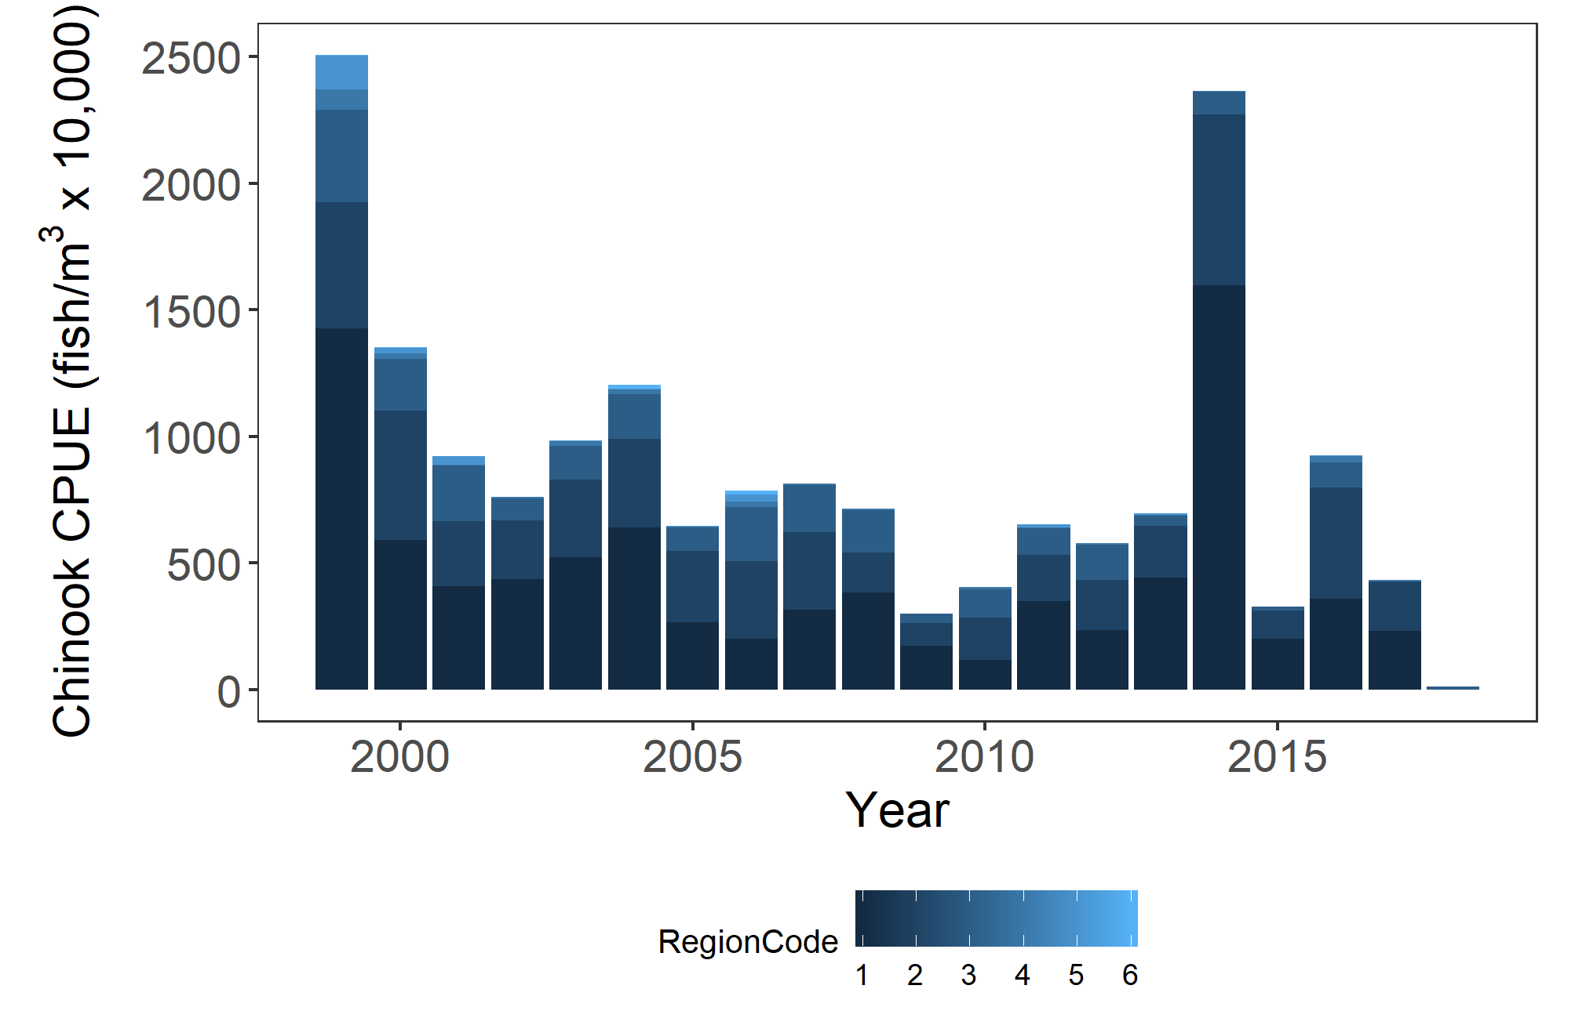
Juvenile Chinook Salmon
Interagency Ecological Program Status & Trends 2017-2018 Winter Season Report
Red Bluff Diversion Dam
DJFMP beach seine
Map of sampling sites
Juvenile Chinook pass Red Bluff Diversion Dam as they migrate from spawning grounds to the ocean.
Sampling at the dam provides an estimate of production in the upper watershed.
USFWS’s Delta Juvenile Fish Monitoring Program runs beach seines to show landscape patterns of juvenile Chinook Salmon.
Researchers use these patterns to determine differences in salmon life-history.

Slide 8
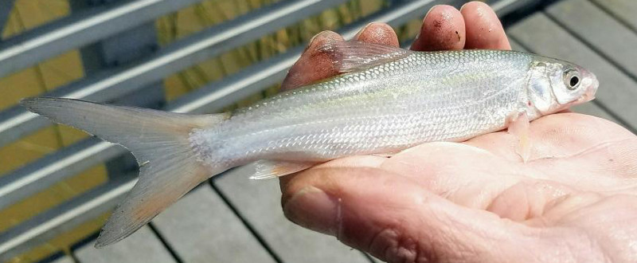
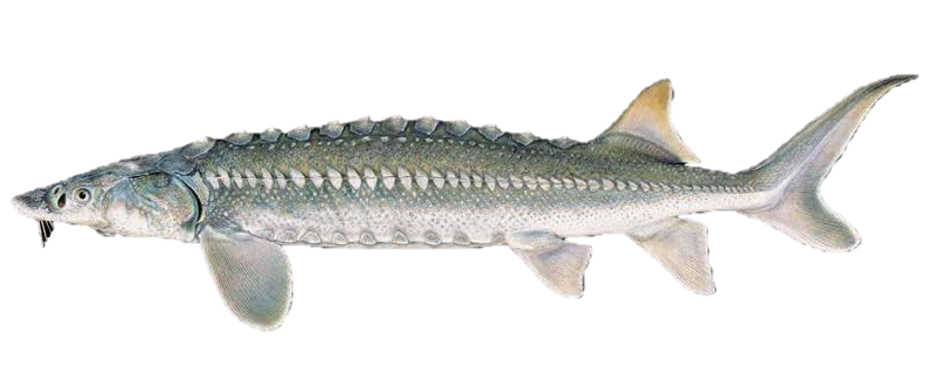
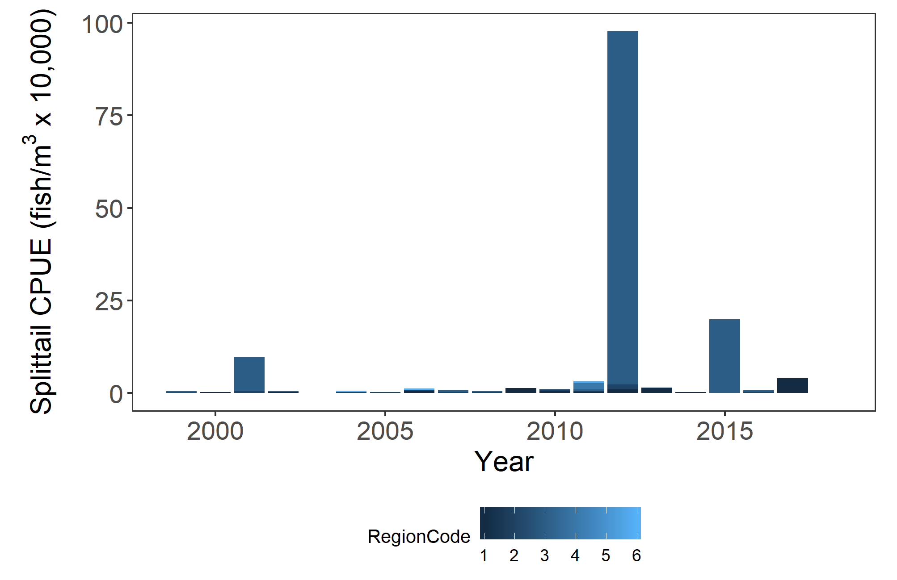
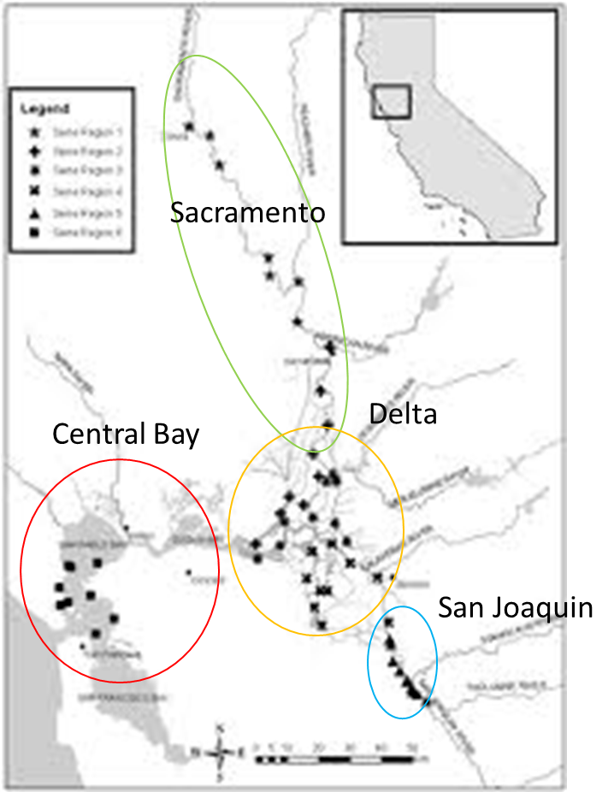
Other Fish
Interagency Ecological Program Status & Trends 2017-2018 Winter Season Report
White Sturgeon – Bay Study
Splittail – DJFMP beach seine
Recent trends inset
DJFMP sampling sites
Bay Study sampling sites
White sturgeon support a recreational fishery
Juvenile sturgeon are caught in CDFW’s San Francisco Bay Study’s otter trawl.
Splittail are a native minnow and considered a Species of Special Concern by CDFW
Splittail spawn on flood plains and do particularly well in wet years.
They are sampled by USFWS’s Delta Juvenile Fish Monitoring Program beach seines.

